Slide 1
KLE Society’s Degree College Bachelor of Computer Application Nagarbhavi, Bangalore
“CAMPUS RECRUITMENT PREDICTION AND ANALYSIS USING MACHINE LEARNING”
Submitted By
Nithya R
(U03FS21S0070)
Under the Guidance of:
Prinston Smart Engineers

Slide 2
CONTENTS
Abstract
Introduction
Company Profile
Problem Statement
Objective
Dataset
Libraries Used
Implementation (Code)
Snapshots of the Project
Conclusion

Slide 3
ABSTRACT
Campus placement prediction and analysis is a data-driven approach to help educational institutions and companies make informed decisions related to campus recruitment. In this project, we aim to analyze the data of campus recruitment from past years and predict the hiring trends for the future. We will use machine learning algorithms to analyze various factors such as academic performance, extra-curricular activities, and other relevant parameters to predict the likelihood of a student being recruited. This analysis and prediction model will help companies make informed decisions while recruiting and provide students with insights into their chances of getting hired. The project's benefits include assisting students in the current batch in identifying suitable statistics about their senior’s placements, which provide them with valuable insights into their preferred job prospects. The analysis can also help institutions optimize their placement processes by identifying areas for improvement, such as providing additional training to students in specific areas of expertise. Overall, campus placement prediction and analysis can offer insightful information into the hiring process and assist businesses and educational institutions in making data-driven decisions to improve their hiring outcomes.

Slide 4
INTRODUCTION
"The goal is to turn the data into information and information into insights," says Carly Fiorina, former CEO of HP. In today’s era, an integral part of leading a successful organization involves gathering data that can be analyzed to gain greater insights into the business and its customers. Data can be used by organizations to depict the relationships between actions taking place across different locations, departments, and systems in order to uncover hidden patterns and derive useful insights. High school students who want to start a successful career enroll in a course that might lead to a stable job. Therefore, it is vital for students to make a sensible career choice regarding their placement after completing a particular education. Now-a-days educational databases are increasing rapidly. This database contains hidden patterns that provide insights of a student’s performance. The performance differs from one student to another. Campus recruitment analysis refers to the process of studying and evaluating the effectiveness of a company's campus recruitment efforts.

Slide 5
COMPANY PROFILE
Name : PRINSTON SMART ENGINEERS
Main office : Vishnuvardhan Statue Rd, Vishwa Priya Nagar, Begur, Bengaluru, Karnataka, 560068
Phone : 9513106196
Email : Prinston.Smart@gmail.com
Contact Person: Mrs. Farheen Farhath (Managing Director)
Year stand up : 2004
Company category : IT Software/ Embedded

Slide 6
PROBLEM STATEMENT
Using machine learning algorithms we build the prediction model, hese algorithms will analyze the data and help predict the likelihood of a candidate getting recruited based on the input features. By analyzing passenger attributes like percentage, gender, work experience, the objective is to predict candidate will be placed or not.

Slide 7
OBJECTIVES
The objective of a campus recruitment prediction model is to accurately forecast the likelihood of a candidate getting recruited by a company based on various factors. By developing this model, recruiters and companies can make informed decisions about which candidates are more likely to be successful in the recruitment process.
The prediction model aims to streamline the recruitment process by identifying top candidates early on, saving time and resources for both recruiters and candidates. It also helps in improving the overall efficiency of campus recruitment by providing data-driven insights into candidate selection.
Ultimately, the goal of the campus recruitment prediction model is to enhance the recruitment process, increase the chances of successful placements, and ensure a better match between candidates and job opportunities.

Slide 8
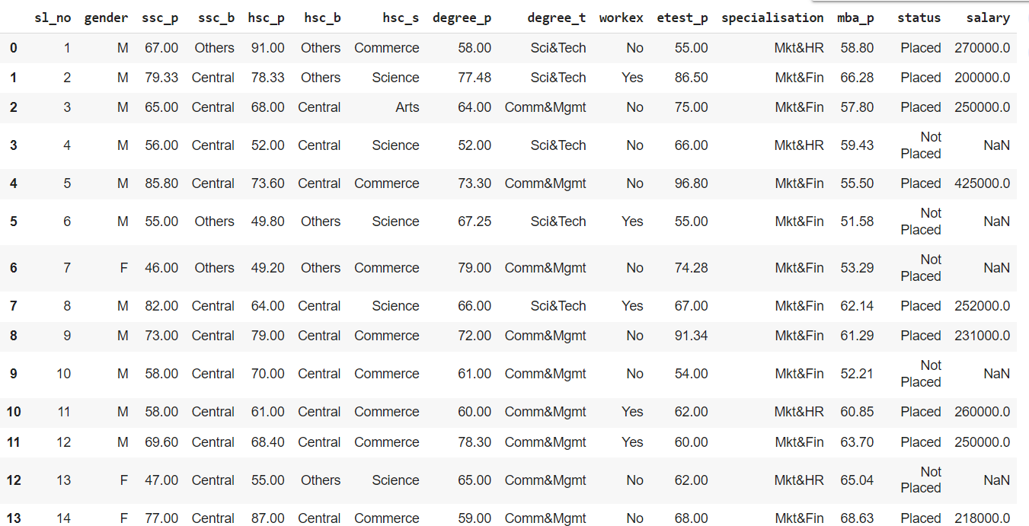
DATASETS

Slide 9
LIBRARIES
Pandas: Pandas is a powerful library for data manipulation and analysis. Pandas can be used to load mutual fund data from CSV files and preprocess the data for machine learning models.
Scikit-learn: Scikit-learn is a popular library for machine learning in Python. Scikit-learn also includes tools for data preprocessing, model selection, and model evaluation. Scikit-learn can be used to train machine learning models for mutual fund classification and regression.
Matplotlib: Matplotlib is a plotting library that is ideal for creating visualizations in Python. Matplotlib can be used to create visualizations of mutual fund data to help investors understand the performance of different funds and categories.
NumPy : It is a fundamental library for scientific computing in Python. It provides support for
Large, multi-dimensional arrays and matrices, as well as a variety of mathematical functions
to operate on these arrays.

Slide 10
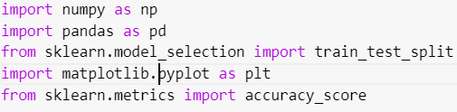
IMPLEMENTATION
#import statements
#loading the database

Slide 11
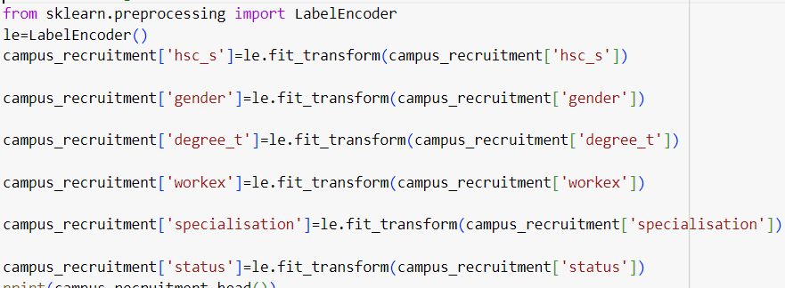
#label encoding
#Splitting into training and testing data

Slide 12


#accuracy check

Slide 13
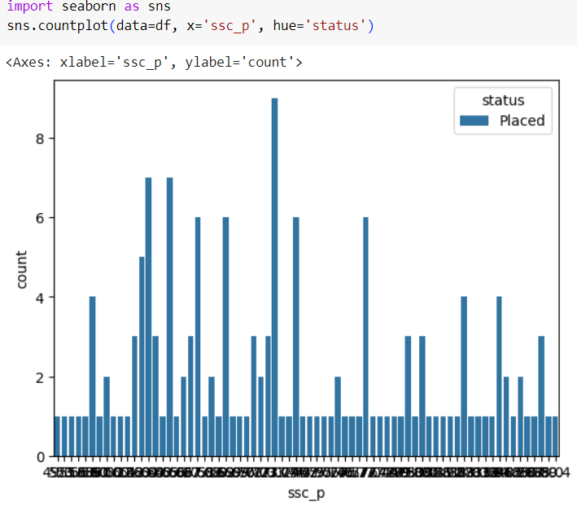
SNAPSHOTS
Analyzing the data based on status

Slide 14
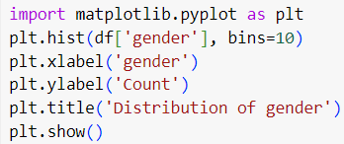
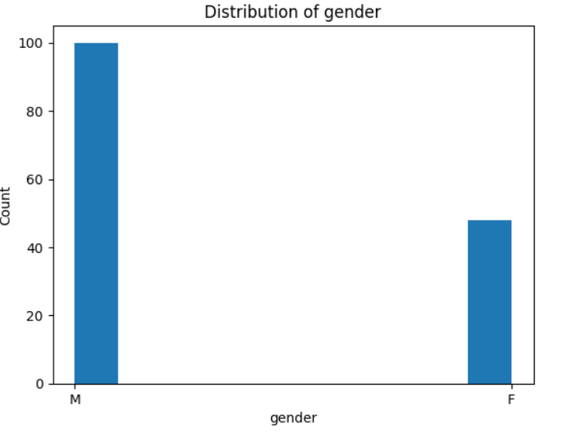
Analyzing the data based on gender

Slide 15
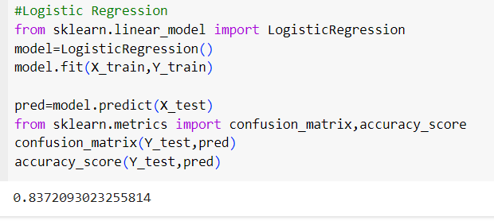

Slide 16
CONCLUSION
Our system achieved an accuracy of 83.72%, which is higher than the existing systems. This indicates that our system is more effective in predicting campus placements than the existing systems. We further evaluated the performance of our system by comparing its precision, recall, and F1-score. Our system achieved a precision of %, a recall of 91.86%, and an F1-score of 89.26%. These results demonstrate the effectiveness of our system in predicting campus placements. In addition, we analyzed the factors that contribute to the success of campus placements, including academic performance, technical skills, and demographic information. Our analysis revealed that academic performance and technical skills are the most significant factors that influence campus placements. Overall, our study demonstrates the effectiveness of our new system for predicting campus placements using machine learning algorithms. The results indicate that our system outperforms existing systems, providing higher accuracy, precision, recall, and F1-score. These findings have important implications for universities and companies, as they can use our system to make more informed decisions about campus placements

Slide 17


